Slide 1



SRI VENKATESWARA COLLEGE OF ENGINEERING MOBILE GAMES RANKING PREDICTION
TEAM MEMBERS
ANNAMALAI L(212712104013)
ARVIND RK(212712104024)
BALAJI B(212712104028)
[BATCH :12]
MENTOR
Ms V.RAJALAKSHMI
AP/CS
5/4/2016

Slide 2
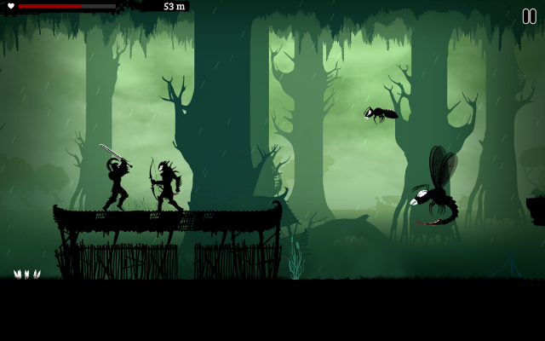
Abstract
Ranking and prediction problems have always been a challenge to rank documents, files, applications etc.
The project aims at providing data analytics, trends and preferred traits of all the games put together at one platform using Gradient Boosting Machine Learning Algorithm.
The main purpose of this project will be to help game developers ballpark the number of downloads they will receive for their game.
2
2
5/4/2016

Slide 3

Basic concepts
Learning to rank:
Application of machine learning in the construction of ranking models for information retrieval systems.
Ranking is a central part of many information retrieval problems.
Eg: document retrieval, collaborative filtering, sentiment analysis, and online advertising.
Approaches:
Point-wise4
Pair-wise
List-wise.
3
3
5/4/2016

Slide 4

Basic concepts (Contd..)
Point-wise approach:
It is assumed that each query-document pair in the training data has a numerical or ordinal score.
The output of ranking is treated as points.
Then learning-to-rank problem can be approximated by a regression problem — given a single query-document pair, predict its score.
MART(Multiple Additive Regression Trees):
It is a commercial implementation of gradient boosting which is trademarked.
4
4
5/4/2016

Slide 5

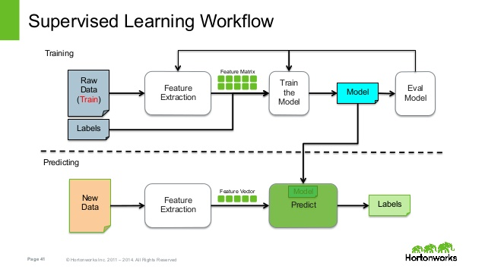
Basic concepts (Contd..)
Supervised Learning:
A supervised learning algorithm analyses the training data and produces an inferred function, which can be used for mapping new examples.
An optimal scenario will allow for the algorithm to correctly determine the class labels for unseen instances.
5
5
5/4/2016

Slide 6

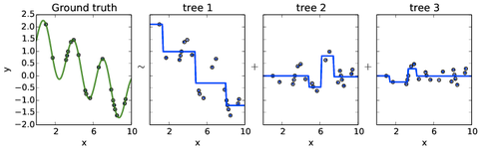
Basic concepts (Contd..)
Gradient boosting:
Gradient boosting is a machine learning technique for regression and classification problems.
It produces a prediction model in the form of an ensemble of weak prediction models, typically decision trees.
6
6
5/4/2016

Slide 7
Gradient Boosting Algorithm
Make a set of predictions ŷ[i] one for each data point
The error in our predictions is J(y, ŷ)
J relates the accuracy of ŷ in modelling y.
Mean Squared Error J(.)= Σ (y[i] - ŷ[i]) ²
ŷ is adjusted to reduce the error.
ŷ[i] = ŷ[i] + alpha f[i] where
alpha is the step
f[i] is the gradient
f[i] ≈ ∇ J(y,ŷ) = (y[i] - ŷ[i]) for MSE
Each learner estimates the gradient of the loss function
7
7
5/4/2016

Slide 8

Gradient Boosting Algorithm(Contd.)
clf = GradientBoostingClassifier(n_estimators=100, learning_rate=1.0,max_depth=1,
random_state=0).fit(X_train, y_train)
learning_rate : float, optional (default=0.1)
Learning rate shrinks the contribution of each tree.
The learning_rate is a hyper-parameter in the range (0.0, 1.0]
n_estimators : int (default=100)
The number of boosting stages to perform.
A large number usually results in better performance.
max_depth : integer (default=3)
maximum depth of the individual regression estimators.
8
8
5/4/2016

Slide 9

Gradient Boosting Algorithm(Contd.)
max_depth : integer, optional (default=3)
The maximum depth of the individual regression estimators.
Functions:
fit(X, y[, sample_weight, monitor])
Fit the gradient boosting model.
Parameters
X:Training vectors
y:Target values
Sample_weight: Sample weights
monitor: A reference to the estimator and the local variables of fit_stages.
9
9
5/4/2016

Slide 10
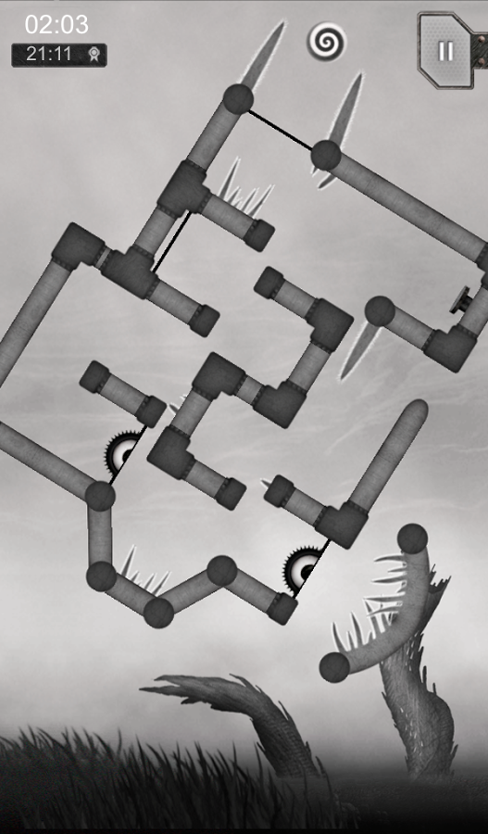
RankLib
java -jar RankLib.jar -train Downloads/qidtrain.txt -ranker 0
-metric2t NDCG@10 -metric2T ERR@10 -save mymodel.txt
-metric2T <metric> Metric to evaluate on the test data.
-ranker <type> Specify which ranking algorithm to use
-metric2t <metric> Metric to optimise on the training data.
-train <file> Training data
-save <model> Save the learned model to the specified file
java -jar RankLib.jar -load mymodel.txt -rank Downloads/qidtrain.txt -score myscorefile.txt
-load <model> The model to load
-rank <file> Rank the samples in the specified file
-score <file> Store ranker's score for each object being ranked
10
10
5/4/2016

Slide 11

Literature Survey
H. Li , Learning to Rank for Information Retrieval and Natural Language Processing, 1 ed., Morgan & Claypool Publishers, 2011, p. 114
Various ranking problems in information retrieval and natural language processing can be formalized as two basic ranking tasks, namely
Ranking creation (or simply ranking) and
Ranking aggregation.
Popular learning to rank methods are introduced such as PRank, OC SVM, McRank, Ranking SVM, IR SVM, GBRank, RankNet, ListNet & ListMLE, LambdaRank.
11
11
5/4/2016

Slide 12

Literature Survey (Contd..)
D. Gillblad, "On Practical Machine Learning and Data Analysis," in Doctoral Thesis, Stockholm, KTH School of Computer Science and Communication, 2008.
When applying machine learning methods to complex data, the processes generating the data must be modelled in an appropriate way so that calculations are performed in an efficient manner.
A statistical modelling framework, Hierarchical Graph Mixtures is introduced, based on a combination of graphical models and mixture models is used.
It allows us to create consistent, expressive statistical models that simplify the modelling of complex systems.
12
12
5/4/2016

Slide 13

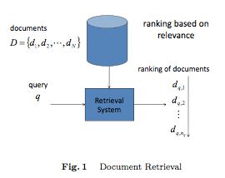
Literature Survey (Contd..)
H. Li, "A Short Introduction to Learning to Rank," in IEICE Transactions on Information and Systems, 2011..
Introduces to learning to rank, and it specifically explains the fundamental problems, existing approaches, and future work of learning to rank.
Several learning to rank methods using SVM techniques are described in details.
Describes a number of issues in learning for ranking, including training and testing, data labelling, feature construction, evaluation, and relations with ordinal classification in the field of Document Retrieval.
13
13
5/4/2016

Slide 14
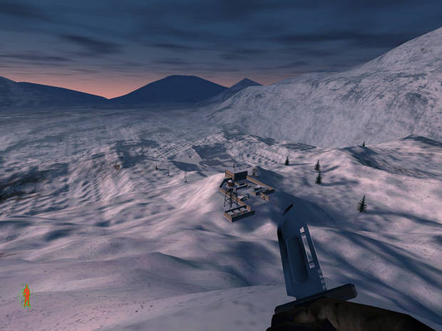
Literature Survey (Contd..)
C. Burges, T. Shaked, E. Renshaw, A. Lazier, M. Deeds, N. Hamilton and G. Hullender, "Learning to Rank Using Gradient Descent," in ICML '05 Proceedings of the 22nd International conference on Machine Learning, New York, NY, USA, 2005.
Any system that presents results to a user, ordered by a utility function that the user cares about, is performing a ranking function.
Proposes a simple probabilistic cost function, and introduces Ranknet which is used in the learning to rank algorithm.
Overcomes the problems faced in Ordinal Regression functions.
Labelling is used based on relevance of the query to the output i.e., “excellent match”, “good match”, etc.
14
14
5/4/2016

Slide 15
Literature Survey (Contd..)
The Lemur project – Wiki – RankLib [online].
RankLib is a library of learning to rank algorithms. Currently eight popular algorithms have been implemented.
It also implements many retrieval metrics as well as provides many ways to carry out evaluation.
Acquires Datasets from the LETOR Database.
LETOR is a package of benchmark data sets for research on Learning to Rank.
15
15
5/4/2016

Slide 16

Issues and Challenges
Design of Ranking Algorithm
Cannot extrapolate
Requires slow and Extensive training
Design of Prediction Algorithm
16
16
5/4/2016

Slide 17

Problem Definition
To develop a Mobile Game Prediction System for top mobile games prediction and providing the range of downloads and estimated Ranking for the games along with the trends and traits of the top games, thereby enabling the developers to design a good game with ease.
17
17
5/4/2016

Slide 18
Modules
Data Collector
Ranking System
Predictor
18
18
5/4/2016

Slide 19
Architecture
Data Collector
Ranking System
Data Explorer
Data Filter
Data Storage
19
19
Feature Extraction and Selection
Ranking Learning
Ranking Model
Prediction System
User Interface
Predictor
Output Viewer
5/4/2016

Slide 20
Data Collector
The Data Collector module has three components
Data Explorer : It gathers the data from the large sources which are mainly internet ,experts and magazines.
Data Filter : Prevents and excludes noise data from the Data Explorer.
Extraction and Selection : It includes only the extracted and selected attributes from data.
20
20
5/4/2016

Slide 21

Ranking System
This module plays a major role where Learning to rank algorithm works.
It contains :
Dataset Storage: The datasets which are extracted from the feature extraction are stored in this Dataset storage.
Ranking Learning: The Learning Ranking component performs training and evaluation using datasets in the Dataset Storage.
Ranking Model : It is model container which is ready to be employed for prediction after being trained in Ranking Learning.
21
21
5/4/2016

Slide 22
Predictor
This predictor works as a User interface module or user view module.
It contains three components:
Input Interface : This is shown to users as input user interface for the prediction which contains query input.
Predictor : It is the main component which predicts new input from the users using model from Ranking Model component.
Output Viewer : This delivers the prediction from the Predictor as ranking and is shown in understandable user interface.
22
22
5/4/2016

Slide 23

System Requirements and Tools
Software Requirements:
Java DE
MySQL
RankLib Tool
Python package
Hardware Requirements:
1.3GHz Core i5
2GB Ram
500MB of SSD Space
WindowsXP/Leopard
23
23
5/4/2016

Slide 24
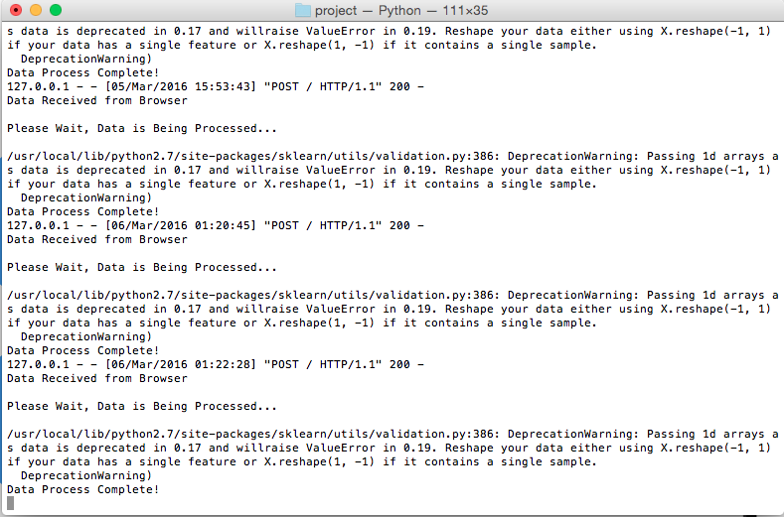
Screenshots
24
24
5/4/2016

Slide 25
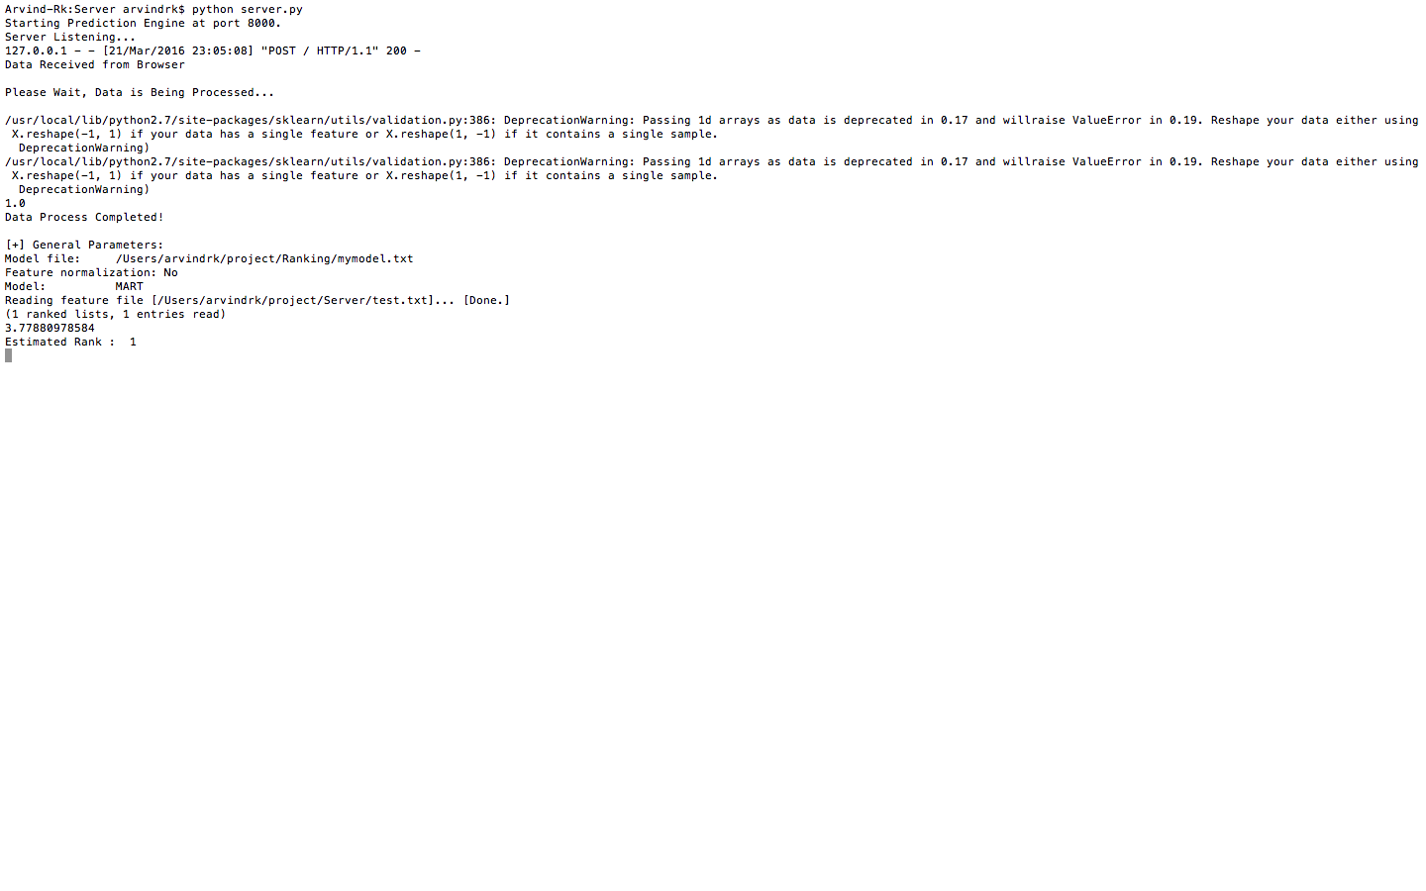
Screenshots(Contd.)
25
25
5/4/2016

Slide 26
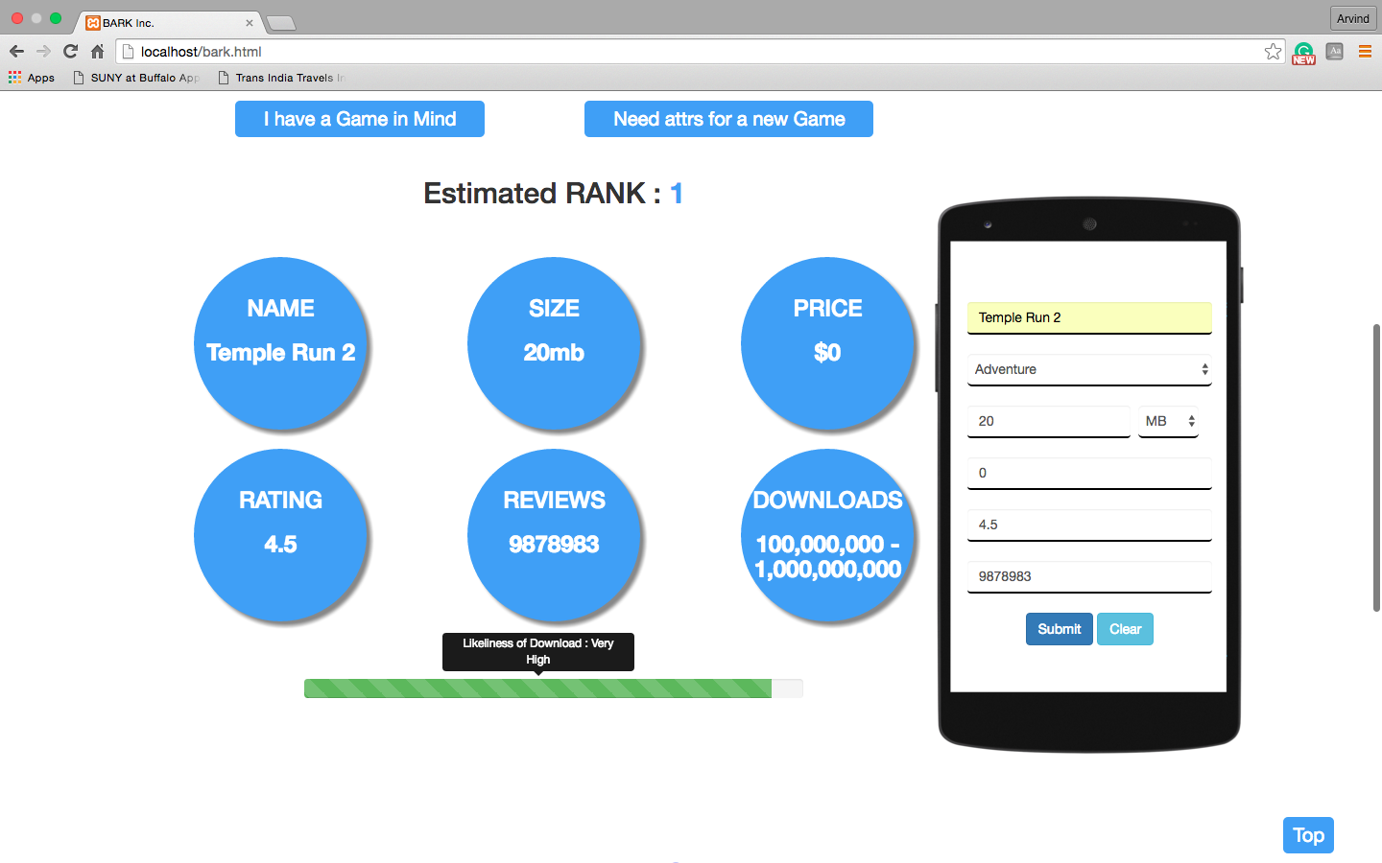
Screenshots(Contd.)
26
26
5/4/2016

Slide 27

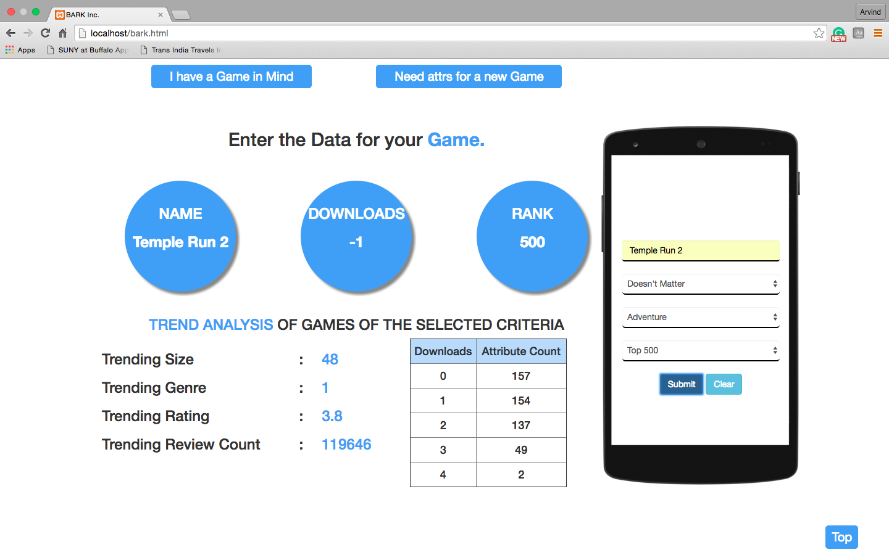
Screenshots(Contd.)
27
27
5/4/2016

Slide 28
Conclusion
Thus Mobile Game Prediction and Ranking System has been implemented for efficient development of mobile games by game developers.
In addition to finding the predicted downloads, the estimated rank and trends of successful games can be analysed.
As future work real time attributes like complexity, graphics involved, date published ( historic value ), game play can be considered in order to improve the results. Image processing can be used to make predictions based on game play and graphics.
28
28
5/4/2016

Slide 29

References
T. V. Agten (2013), "Games: King of the mobile eco-system," Distimo.
Alfian Ramadhan, Masayu Leylia Khodra (2014) “Learning to Rank for Top Mobile Games Prediction,” in 2nd International Conference on Information and Communication Technology (ICoICT).
C. Burges, T. Shaked, E. Renshaw, A. Lazier, M. Deeds, N. Hamilton and G. Hullender (2005) "Learning to Rank Using Gradient Descent," in ICML '05 Proceedings of the 22nd international conference on Machine Learning, New York, NY, USA.
W. Chen, T.-Y. Liu, Y. Lan, Z. Ma and H. Li (2009), "Ranking Measures and Loss Functions," in Advances in Neural Information Processing Systems.
K. Chulis (2012) "Big data analytics for video, mobile, and social game monetization," IBM Corporation.
29
29
5/4/2016

Slide 30
References
S. Clemencon, M. Depecker and N. Vayatis (2013), "Ranking Forests," The Journal of Machine Learning Research, vol. 14, no. 1, pp. 39-73.
K. Crammer and Y. Singer (2001), "Pranking with Ranking," in Advances in Neural Information Processing System 14.
D. Gillblad (2008) "On Practical Machine Learning and Data Analysis," in Doctoral Thesis, Stockholm, KTH School of Computer Science and Communication.
H. Li (2011) Learning to Rank for Information Retrieval and Natural Language Processing, 1 ed., Morgan & Claypool Publishers, p. 114
H. Li (2011) "A Short Introduction to Learning to Rank," in IEICE 48 Transactions on Information and Systems.
V. Dang, "The Lemur Project - Wiki - RankLib," Lemur Project. Available: http://sourceforge.net/p/lemur/wiki/RankLib/.
30
30
5/4/2016

Slide 31

THANK YOU
31
31

